Slide 1
InSpec Developer Course 102
Last Updated: 01/16/19
Commit #: 747183e

Slide 2
Table of contents
About InSpec
Course Overview
Environment Setup
Creating InSpec profile
InSpec Shell
Analyze Results
Automation Tools
Create basic profile

Slide 3
About InSpec
InSpec is an open-source, community-developed compliance validation framework
Provides a mechanism for defining machine-readable compliance and security requirements
Easy to create, validate, and read content
Cross-platform (Windows, Linux, Mac)
Agnostic to other DevOps tools and techniques
Integrates into multiple CM tools

Slide 4
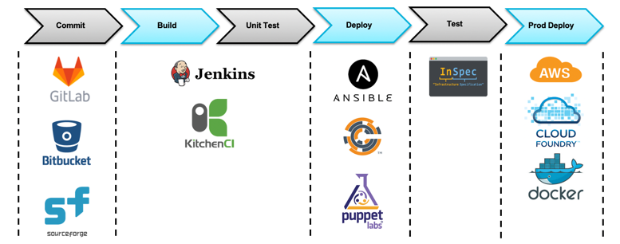
Orchestration, Configuration Management, Validation to Deployment
InSpec operates with most orchestration and CM tools found in the DevOps pipeline implementations

Slide 5
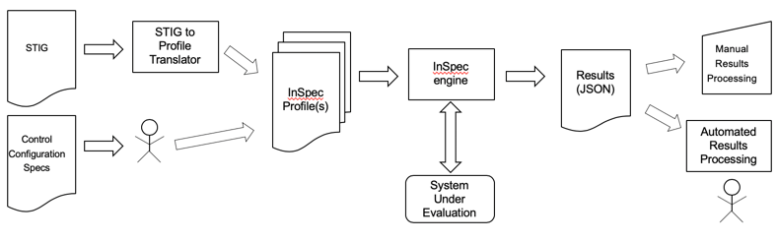
Automating Security Validation Using InSpec

Slide 6
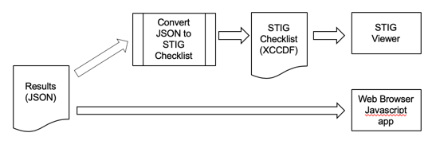
Processing InSpec Results

Slide 7
Course Overview
InSpec Profile Structure
InSpec Controls Structure
InSpec Results
Failure
Pass
Multiple Controls
Tooling and Reporting

Slide 8
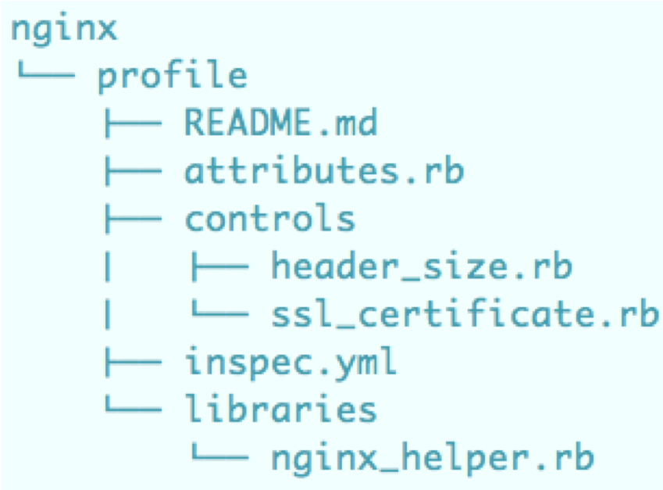
InSpec Profile Structure

Slide 9
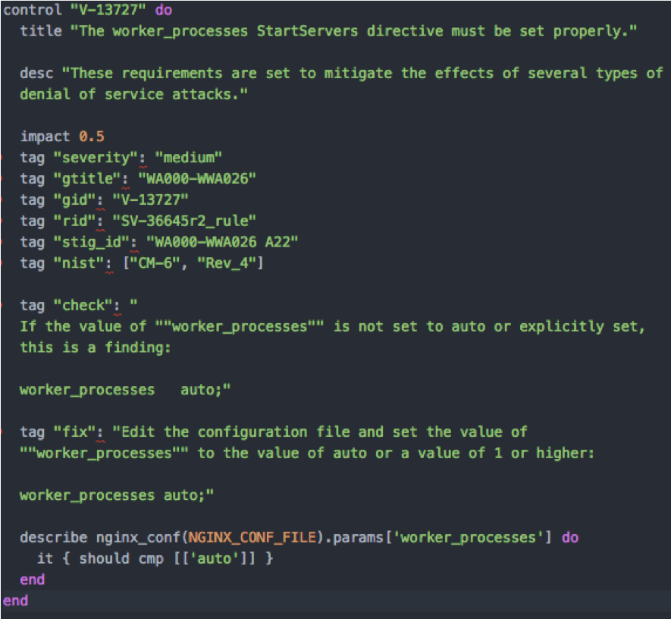
InSpec Controls Structure

Slide 10
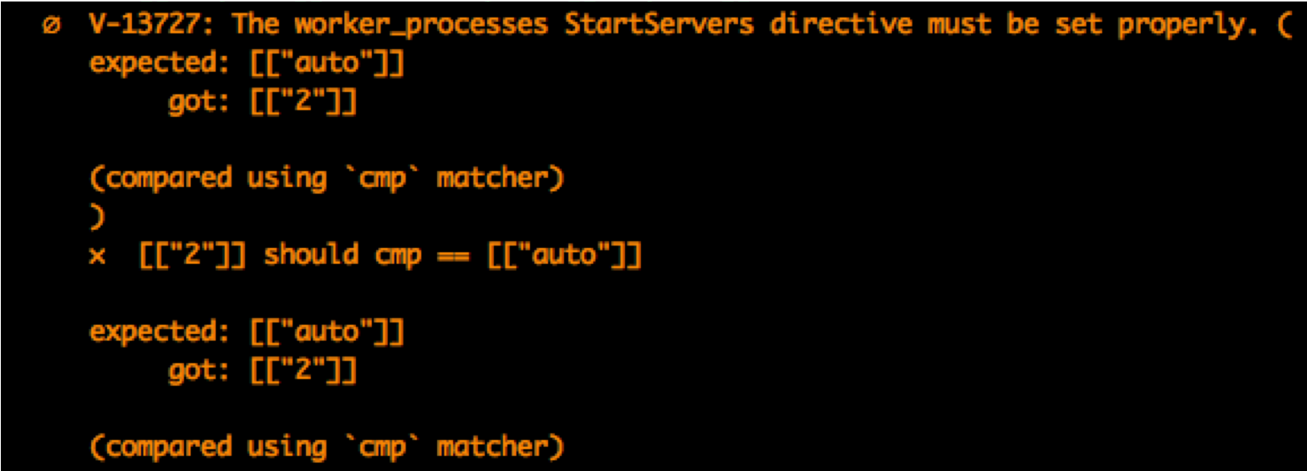
InSpec Results - Failure

Slide 11
InSpec Results - Pass

Slide 12
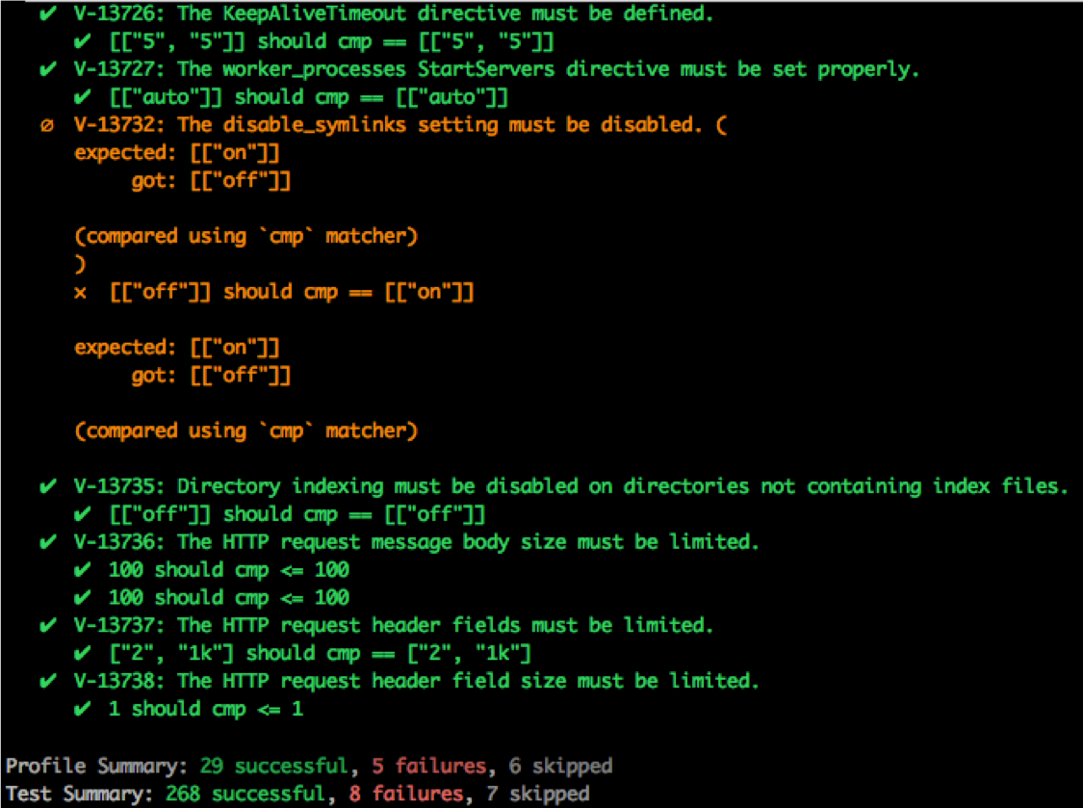
InSpec Results – Multiple Controls

Slide 13
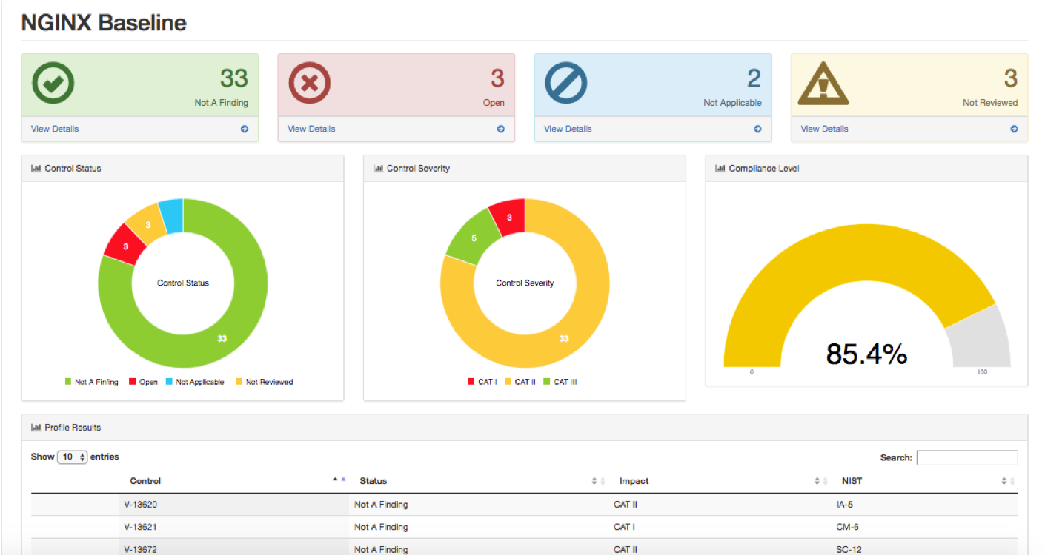
Tooling and Reporting

Slide 14
Environment Setup
Download VirtualBox Here:
https://www.virtualbox.org/wiki/Downloads
Download VirtualBox Template Here
Placeholder

Slide 15
Setup Environments
Start by creating a working directory. We recommend ~/learn-inspec.
mkdir ~/learn-inspec
Next, move to your working directory.
cd ~/learn-inspec
Share folder on VirtualBox
Create Shared Folder in VirtualBox that links to the above folder
Mount the Shared Folder on both Workstation and Target

Slide 16
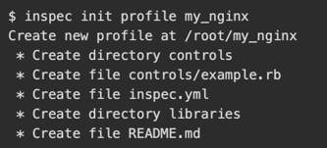
Creating InSpec profile
Open up the workstation Virtual Machine
Let's start by creating a profile that will contain NGINX tests.
Start by moving to the /root directory.
cd ~
Next, create an InSpec profile named my_nginx.
inspec init profile my_nginx
The terminal output should look like the following:

Slide 17
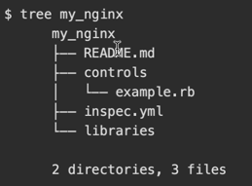
Understanding the profile structure
Let's take a look at how the profile is structured. We'll start with how a profile's files are structured and then move to what makes up an InSpec control.
First, run `tree` to see what's in the `my_nginx` profile.
Here's the role of each component.
`README.md` provides documentation about the profile, including what it covers and how to run it.
The `controls` directory contains files which implement the InSpec tests.
`inspec.yml` provides metadata, or information, about the profile. Metadata includes the profile's description, author, copyright, and version.
The `libraries` directory contains resource extensions. A resource extension enables you to define your own resource types. You won't work with resource extensions in this module.

Slide 18
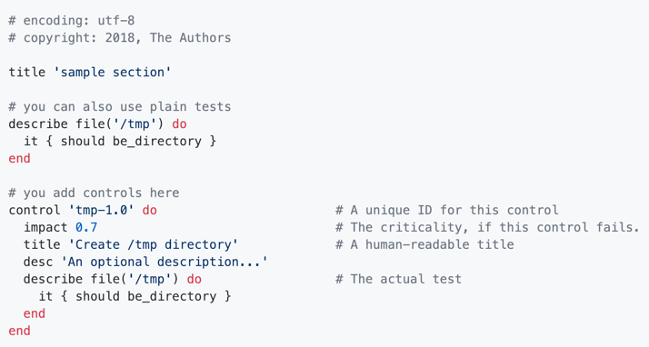
Understand a control's structure
Let's take a look at the default control file, `controls/example.rb`.

Slide 19
Understand a control's structure cont’d
This example shows two tests. Both tests check for the existence of the `/tmp` directory. The second test provides additional information about the test. Let's break down each component.
`control` (line 12) is followed by the control's name. Each control in a profile has a unique name.
`impact` (line 13) measures the relative importance of the test and must be a value between 0.0 and 1.0.
`title` (line 14) defines the control's purpose.
`desc` (line 15) provides a more complete description of what the control checks for.
`describe` (lines 16 — 18) defines the test. Here, the test checks for the existence of the `/tmp` directory.
In Ruby, the `do` and `end` keywords define a block. An InSpec control always contains at least one `describe` block. However, a control can contain many `describe` blocks.

Slide 20

Understand a describe block's structure
As with many test frameworks, InSpec code resembles natural language. Here's the format of a describe block.
An InSpec test has two main components: the subject to examine and the subject's expected state. Here, `<entity>` is the subject you want to examine, for example, a package name, service, file, or network port. The `<expectation>` part specifies the desired result or expected state, for example, that a port should be open (or perhaps should not be open.)

Slide 21

Understand a describe block's structure cont’d
Let's take a closer look at the `describe` block in the example.

Slide 22
Understand a describe block's structure cont’d
Because InSpec resembles human-readable language, you might read this test as "/tmp should be a directory." Let's break down each component.
file
file is an InSpec resource. If you're familiar with Chef, you know that a resource configures one part of the system. InSpec resources are similar. For example, the InSpec file resource tests for file attributes, including a file's owner, mode, and permissions. The example examines the /tmp directory.
it
The `it` statement validates one of your resource's features. A `describe` block contains one or more `it` statements. `it` enables you to test the resource itself. You'll also see `its`, which describes some feature of the resource, such as its mode or owner. You'll see examples of both `it` and `its` shortly.
should
`should` describes the expectation. `should` asserts that the condition that follows _should_ be true. Alternatively, `should_not` asserts that the condition that follows _should not_ be true. You'll see examples of both shortly.
be_directory
`be_directory` is an example of a matcher. A matcher compares a resource's actual value to its expected value. InSpec provides several predefined matchers. The `file` resource provides the `be_directory` matcher.

Slide 23
InSpec Shell
Before we test our NGINX configuration, let's plan which resources and matchers we'll need.
When writing InSpec code, many resources are available to you.
You can explore the InSpec documentation to see which resources and matchers are available.
You can examine the source code to see what's available. For example, you can see how file and other InSpec resources are implemented.
You can also use examples, such as profiles provided on Chef Supermarket, as a guide.
There's also InSpec shell, which enables you to explore InSpec interactively. In this part, you'll use the InSpec shell to discover which resources you can use to test your NGINX configuration.
You're not required to use InSpec shell to develop your profiles. Some users find the InSpec shell to be a useful way to get immediate feedback and explore what's available. You can also use InSpec shell to debug your profiles.

Slide 24
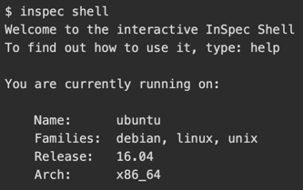
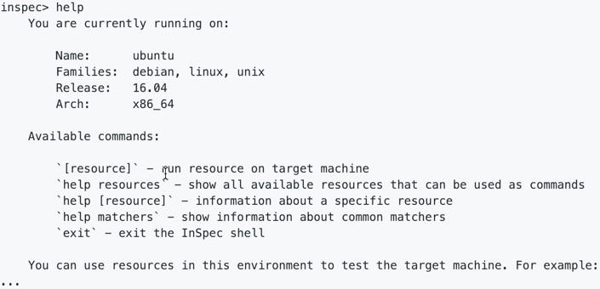
Enter the shell
Run `inspec shell` to enter the interactive session.
Run `help` to see what commands are available.

Slide 25
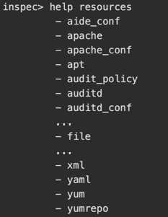
Enter the shell cont’d
Run `help resources` to see which resources are available.
You see `file` and other resources listed.

Slide 26
Explore the file resource
Earlier, you saw this `describe` block.
Let's run a few commands from the InSpec shell to see how the `file` resource works.

Slide 27
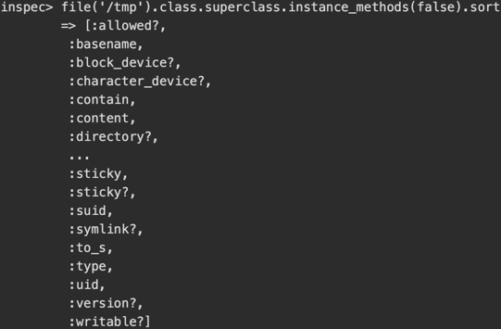
Explore the file resource cont’d
InSpec is built on the Ruby programming language. InSpec matchers are implemented as Ruby methods. Run this command to list which methods are available to the `file` resource.
You can use the arrow or Page Up and Page Down keys to scroll through the list. When you're done, press `Q`.

Slide 28

Explore the file resource cont’d
InSpec shell is based on a tool called pry. If you're not familiar with pry or other REPL tools, later you can check out pry to learn more.
As an example, call the `file.directory?` method.
You see that the `/tmp` directory exists on your workstation container.
InSpec transforms resource methods to matchers. For example, the `file.directory?` method becomes the `be_directory` matcher. The `file.readable?` method becomes the `be_readable` matcher.

Slide 29
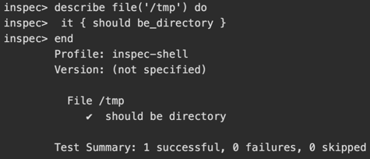
Explore the file resource cont’d
The InSpec shell understands the structure of blocks. This enables you to run mutiline code. As an example, run the entire `describe` block like this.
In practice, you don't typically run controls interactively, but it's a great way to test out your ideas.
A Ruby method that ends in ?, such as directory? is known as a predicate method. The ? syntax is intended to make Ruby code easier to read.
A predicate method typically returns a value that can be evaluated as true or false. In Ruby, false and nil are false; everything else evaluates to true.

Slide 30
Explore the nginx resource
Now's a good time to define the requirements for our NGINX configuration. Let's say that you require:
NGINX version 1.10.3 or later.
the following NGINX modules to be installed:
http_ssl
stream_ssl
mail_ssl
the NGINX configuration file, `/etc/nginx/nginx.conf`, to:
be owned by the `root` user and group.
not be readable, writeable, or executable by others.

Slide 31
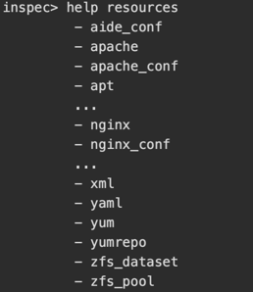
Explore the nginx resource cont’d
Let's see what resources are available to help define these requirements as InSpec controls.
Run `help resources` a second time. Notice InSpec provides two built-in resources to support NGINX – `nginx` and `nginx_conf`.

Slide 32
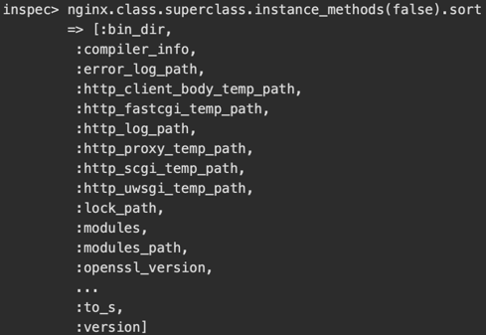
Explore the nginx resource cont’d
Run `nginx.methods`. You see the `version` and `modules` methods. You'll use these methods to define the first two requirements.

Slide 33


Explore the nginx resource cont’d
Run `nginx.version` to see what result you get.
Notice the error. This tells us that NGINX is not installed. Recall that you're working on your workstation container environment, which does not have NGINX installed. Run the following package resource to verify.

Slide 34
Explore the nginx resource cont’d
Although you've discovered the methods you need – `version` and `modules` – let's run InSpec shell commands against the target that does have NGINX installed to see what results we find. To do so, first start by exiting your InSpec shell session.

Slide 35
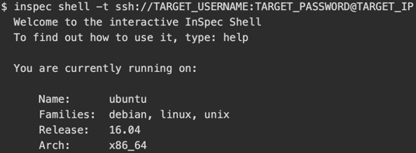
Explore the nginx resource cont’d
Run `inspec shell` a second time. This time, provide the `-t` argument to connect the shell session to the target container. This is similar to how you ran `inspec exec` in the Try InSpec module to scan the target from the workstation.
Remember that the target does not have the InSpec CLI installed on it. Your shell session exists on the workstation container; InSpec routes commands to the target instance over SSH.

Slide 36


Explore the nginx resource cont’d
Run the `package` resource a second time, this time on the target container.
You see that NGINX is installed. Now run `nginx.version`.

Slide 37
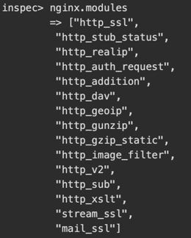
Explore the nginx resource cont’d
You see that version 1.10.3 is installed. To complete the example, run `nginx.modules` to list the installed NGINX modules.
You see that the required modules, `http_ssl`, `stream_ssl`, and `mail_ssl`, are installed.

Slide 38
Explore the nginx resource cont’d
The nginx_conf resource examines the contents of the NGINX configuration file, `/etc/nginx/nginx.conf`.
Recall that the third requirement is to check whether the NGINX configuration file is owned by `root` and is not readable, writeable, or executable by others. Because we want to test attributes of the file itself, and not its contents, you'll use the `file` resource.

Slide 39
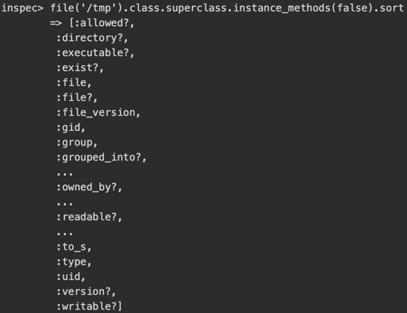
Explore the nginx resource cont’d
You saw earlier how the `file` resource provides the `readable`, `writeable`, and `executable` methods. You would also see that the `file` resource provides the `owned_by` and `grouped_into` methods.

Slide 40
Explore the nginx resource cont’d
These 5 `file` methods – `grouped_into`, `executable`, `owned_by`, `readable` and `writeable` – provide everything we need for the third requirement.
Exit the InSpec shell session.

Slide 41
Write the InSpec controls
Now that you understand which methods map to each requirement, you're ready to write InSpec controls.
To review, recall that you require:
NGINX version 1.10.3 or later.
the following NGINX modules to be installed:
http_ssl
stream_ssl
mail_ssl
the NGINX configuration file, `/etc/nginx/nginx.conf`, to:
be owned by the `root` user and group.
not be readable, writeable, or executable by others.

Slide 42
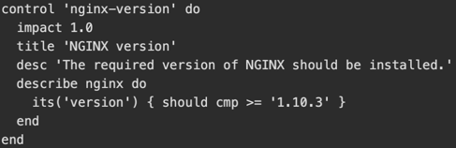
Write the InSpec controls cont’d
The first requirement is for the NGINX version to be 1.10.3 or later. To check this, you use the `cmp` matcher. Replace the contents of `/root/my_nginx/controls/example.rb` with this.
The test has an impact of 1.0, meaning it is most critical. A failure might indicate to the team that this issue should be resolved as soon as possible, likely by upgrading NGINX to a newer version. The test compares `nginx.version` against version 1.10.3.
`cmp` is one of InSpec's built-in matchers. `cmp` understands version numbers and can use the operators ==, <, <=, >=, and >. `cmp` compares versions by each segment, not as a string. For example, "7.4" is less than than "7.30".

Slide 43
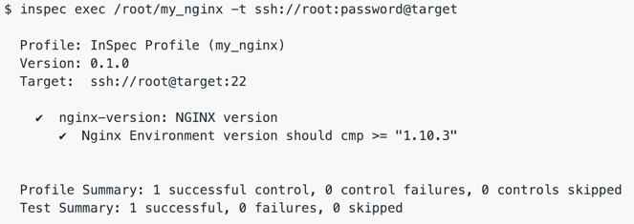
Write the InSpec controls cont’d
Next, run `inspec exec` to execute the profile on the remote target.
You see that the test passes.

Slide 44
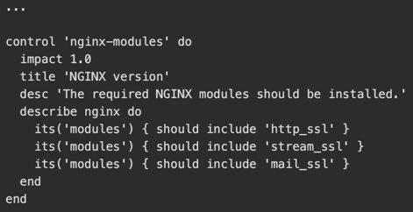
Write the InSpec controls cont’d
The second requirement verifies that these modules are installed.
http_ssl
stream_ssl
mail_ssl
Modify your control file like this.
The second control resembles the first; however, this version uses multiple `its` statements and the `nginx.modules` method. The `nginx.modules` method returns a list; the built-in `include` matcher verifies whether a value belongs to a given list.

Slide 45
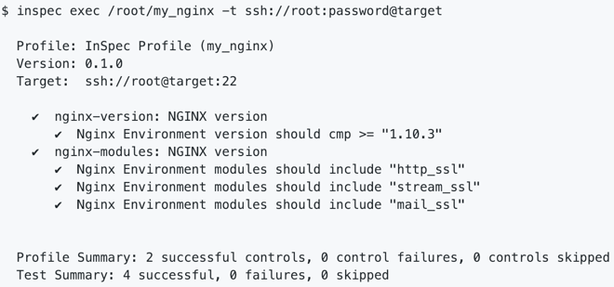
Write the InSpec controls cont’d
Run `inspec exec` on the target.
This time, both controls pass.

Slide 46
Write the InSpec controls cont’d
The third requirement verifies that the NGINX configuration file, `/etc/nginx/nginx.conf`:
be owned by the `root` user and group.
not be readable, writeable, or executable by others.
Modify your control file like this.
control 'nginx-conf' do
impact 1.0
title 'NGINX configuration’
desc 'The NGINX config file should owned by root, be writable only by owner, and not writeable or and readable by others.’
describe file('/etc/nginx/nginx.conf') do
it { should be_owned_by 'root’ }
it { should be_grouped_into 'root’ }
it { should_not be_readable.by('others') }
it { should_not be_writable.by('others') }
it { should_not be_executable.by('others') }
end
end
The third control uses the `file` resource. The first 2 tests use `should` to verify the `root` owner and group. The last 3 tests use `should_not` to verify that the file is not readable, writable, or executable by others.

Slide 47
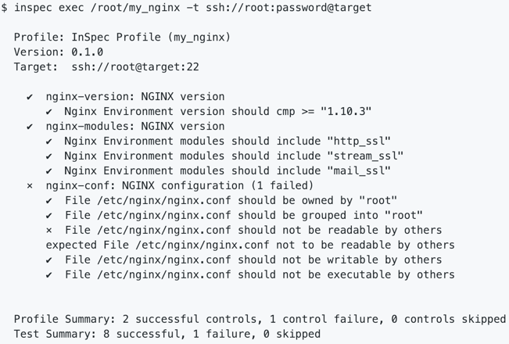
Write the InSpec controls cont’d
Run `inspec exec` on the target.
This time you see a failure. You discover that `/etc/nginx/nginx.conf` is potentially readable by others. Because this control also has an impact of 1.0, your team may need to investigate further.
Remember, the first step, detect, is where you identify where the problems are so that you can accurately assess risk and prioritize remediation actions. For the second step, correct, you can use Chef or some other continuous automation framework to correct compliance failures for you. You won't correct this issue in this module, but later you can check out the Integrated Compliance with Chef track to learn more about how to correct compliance issues using Chef.

Slide 48
Refactor the code to use Attributes
Your `my_nginx` profile is off to a great start. As your requirements evolve, you can add additional controls. You can also run this profile as often as you need to verify whether your systems remain in compliance.

Slide 49
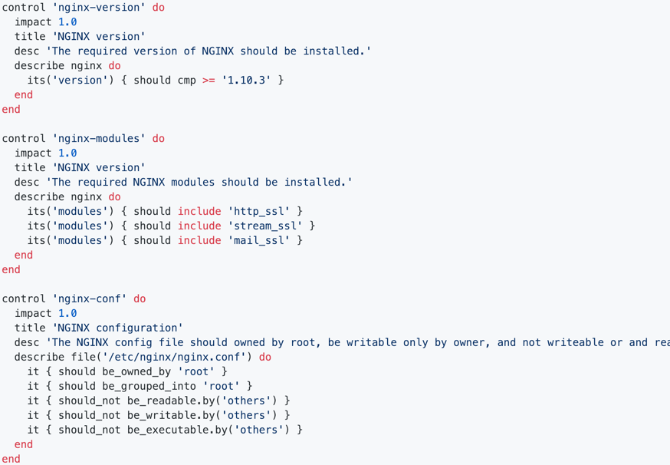
Refactor the code to use Attributes cont’d
Let's review the control file, `example.rb`.

Slide 50
Refactor the code to use Attributes cont’d
Although these rules do what you expect, imagine your control file contains dozens or hundreds of tests. As the data you check for, such as the version or which modules are installed, evolve, it can become tedious to locate and update your tests. You may also find that you repeat the same data in across multiple control files.
One way to improve these tests is to use Attributes. Attributes enable you to separate the logic of your tests from the data your tests validate. Attribute files are typically expressed as a YAML file.
Profile Attributes exist in your profile's main directory within the `inspec.yml` for global Attributes to be used across your profile or in your `attributes` folder for custom Attributes.

Slide 51
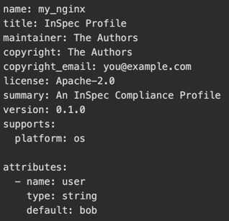
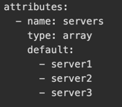
Refactor the code to use Attributes cont’d
Example of attributes in your `inspec.yml`
Example of adding a array object of servers:

Slide 52
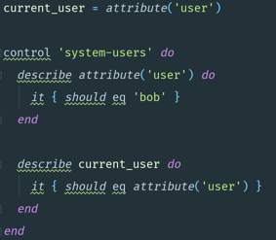
Refactor the code to use Attributes cont’d
To access an attribute you will use the attribute keyword. You can use this anywhere in your control code.
For example:
For sensitive data it is recommended to use a secrets YAML file located on the local machine to populate the values of attributes. A secrets file will always overwrite a attributes default value. To use the secrets file run inspec exec and specify the path to that Yaml file using the --attrs attribute.

Slide 53
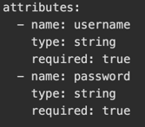
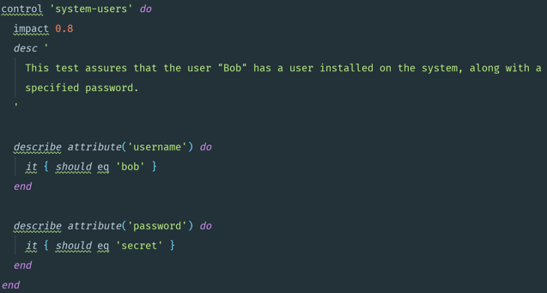
Refactor the code to use Attributes cont’d
For example, a inspec.yml:
The control:

Slide 54



Refactor the code to use Attributes cont’d
To change your attributes for platform specific cases you can setup multiple --attrs files.
For example, a inspec.yml:
A YAML file named windows.yml
A YAML file named linux.yml

Slide 55
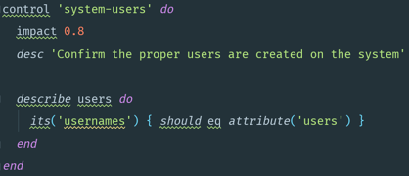
Refactor the code to use Attributes cont’d
The control file:
The following command runs the tests and applies the attributes specified:

Slide 56
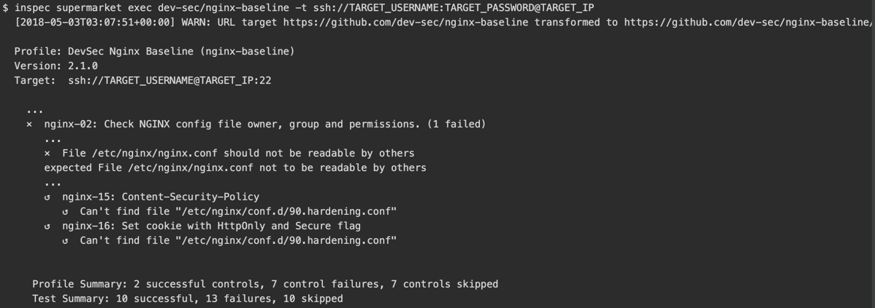
Running baseline straight from Github/Chef Supermarket
In this module, we use NGINX for learning purposes. If you're interested in NGINX specifically, you may be interested in the DevSec Nginx Baseline profile on Chef Supermarket. This profile implements many of the tests you wrote in this module.
To execute this profile on your target system, run this `inspec supermarket exec` command.

Slide 57
Running baseline straight from Github/Chef Supermarket cont’d
You see that many of the tests pass, while others fail and may require investigation.
You may want to extend the `nginx-baseline` with your own custom requirements. To do that, you might use what's called a _wrapper profile_. You can check out Create a custom InSpec profile for a more complete example.

Slide 58
Analyze Results
InSpec allows you to output your test results to one or more reporters. You can configure the reporter(s) using either the --json-config option or the --reporter option. While you can configure multiple reporters to write to different files, only one reporter can output to the screen(stdout).
You can specify one or more reporters using the --reporter cli flag. You can also specify a output by appending a path separated by a colon.

Slide 59


Syntax
Output json to screen.
Output yaml to screen
Output cli to screen and write json to a file.
inspec exec example_profile --reporter cli json:/tmp/output.json

Slide 60
Syntax cont’d
Output nothing to screen and write junit and html to a file.
inspec exec /root/my_nginx --reporter junit:/tmp/junit.xml html:www/index.html
Output json to screen and write to a file. Write junit to a file.
inspec exec /root/my_nginx --reporter json junit:/tmp/junit.xml | tee out.json
If you wish to pass the profiles directly after specifying the reporters you will need to use the end of options flag --.
inspec exec --reporter json junit:/tmp/junit.xml -- profile1 profile2

Slide 61
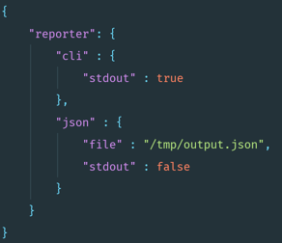
Syntax cont’d
Output cli to screen and write json to a file.

Slide 62
Supported Reporters
The following are the current supported reporters:
cli
json
json-min
yaml
documentation
junit
progress
json-rspec
html
You can read more about InSpec Reporters on the documentation page.

Slide 63
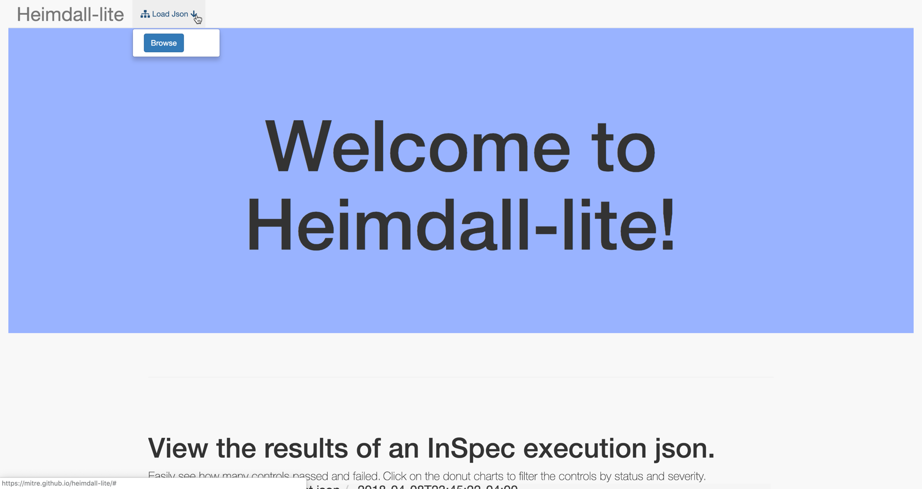
Automation Tools
Navigate to the web page for Heimdall Lite
Click on the button `Load Json`

Slide 64
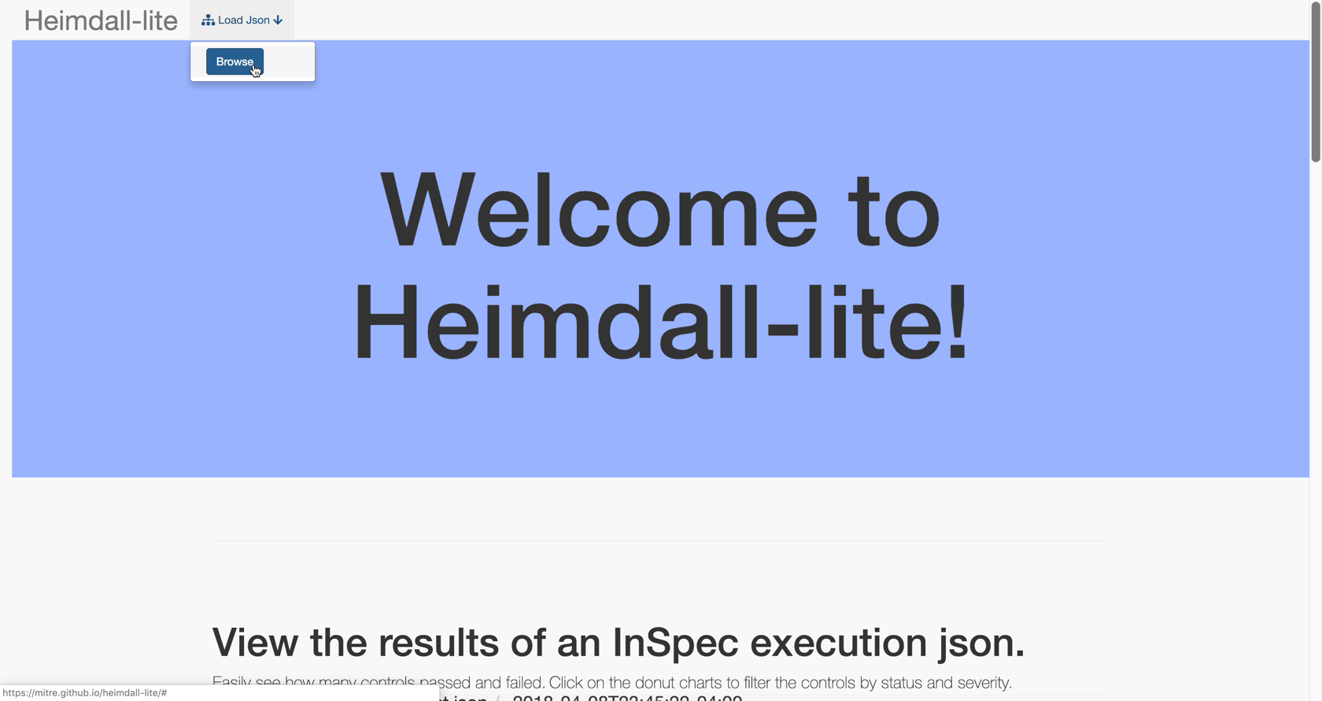
Automation Tools cont’d
Click on the button `Browse`

Slide 65
Automation Tools cont’d
Navigate to your json output file that you saved from your previous step and select that file then click open.
This will allow you to view the InSpec results in the Heimdall viewer.

Slide 66
Create basic profile
Download CIS Here:
CIS Benchmark Download PLACEHOLDER
Start by trying to convert and write the first control yourself.
Download Parsed Controls Here that were parsed using inspec-tools created by MITRE:
CONTROLS PLACEHOLDER

Slide 67
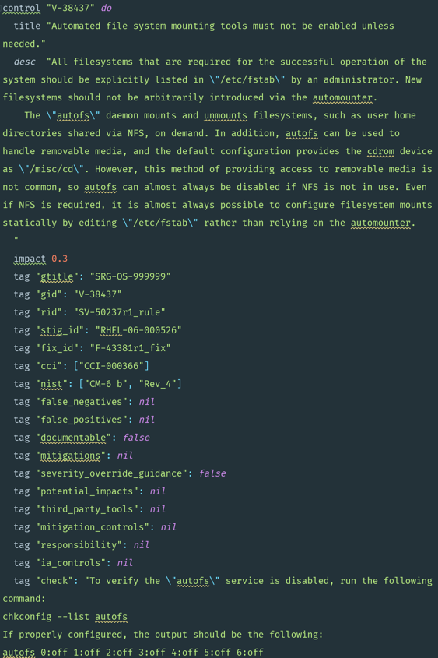
Create basic profile cont’d
Let's take a look at how we would write a the InSpec control for V-38437:

Slide 68
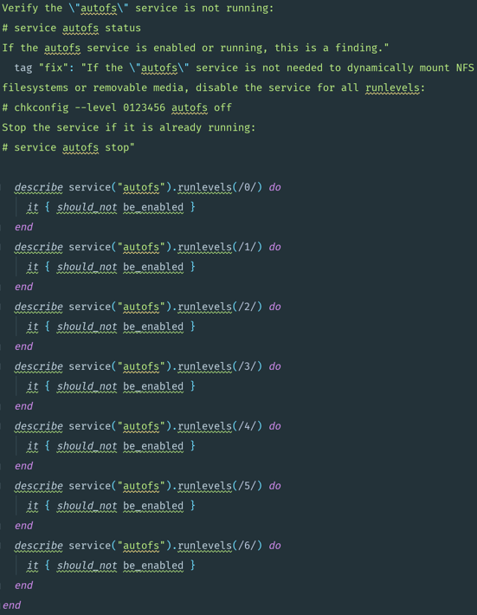
Create basic profile cont’d

